Slide 1
COMP 3500 Introduction to Operating Systems OS Overview
Dr. Xiao Qin
Auburn University http://www.eng.auburn.edu/~xqin
xqin@auburn.edu
Notes:
15 min Lec01b-Project 1 Overview
35 min slides 1-17
Ex 4 and 5 will be covered on Lec01c (i.e., 03)

Slide 2
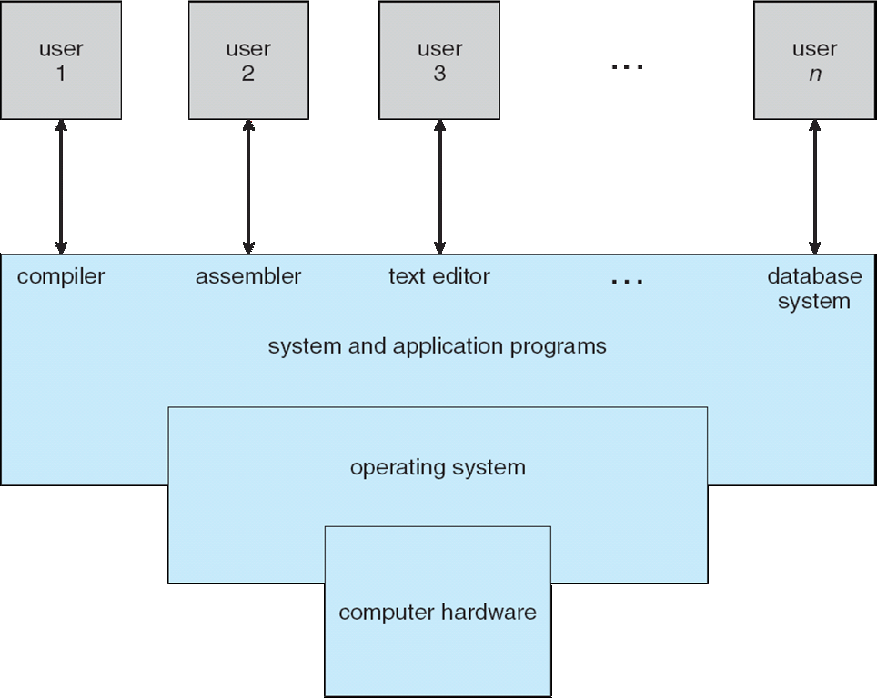
Four Components of a Computer System
Notes:
Computer system can be divided into four components:
Hardware – provides basic computing resources
CPU, memory, I/O devices
Operating system
Controls and coordinates use of hardware among various applications and users
Application programs – define the ways in which the system resources are used to solve the computing problems of the users
Word processors, compilers, web browsers, database systems, video games
Users (May not be a part of computer systems)
People, machines, other computers

Slide 3
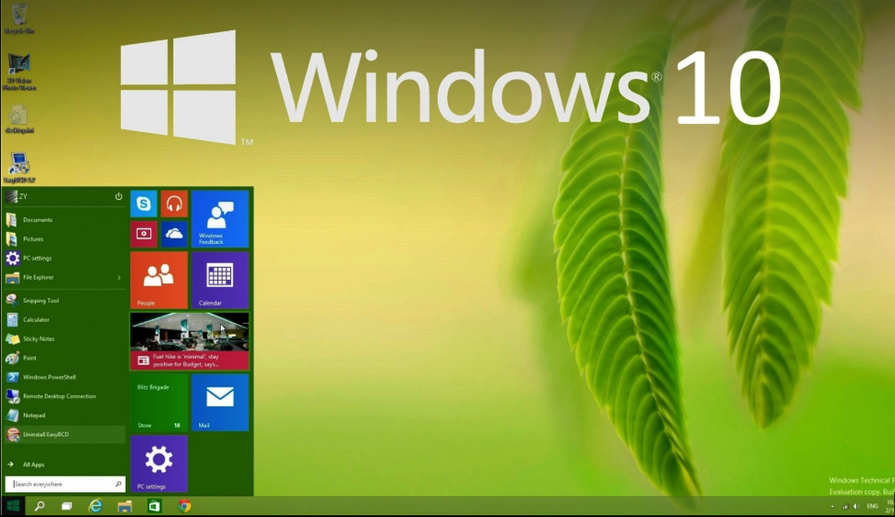
What is an operating system?
OS is a program that acts as an intermediary between a user of a computer and the computer hardware
Notes:
Goals:
Run program
Users: easy use computer systems
Applications: hardware efficiency

Slide 4
Exercise 1(Plickers): Which one of the following item is NOT an operating system goal?
Execute user programs and make solving user problems easier
Make the computer system convenient to use
Improve CPU clock rate
Use the computer hardware in an efficient manner
Notes:
Goals:
Run program
Users: easy use computer systems
Applications: hardware efficiency

Slide 5
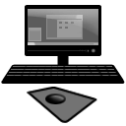
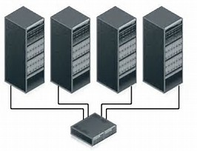
Personal Computers vs. Supercomputers

Slide 6
Exercise 2 (Plickers): Choose one item below that end users don’t want from operating systems
Convenience
Ease of use
Short response time
Fast throughput
Notes:
User vs. System views
Users want convenience, ease of use and good performance
Don’t care about resource utilization
But shared computer such as mainframe or minicomputer must keep all users happy
Users of dedicate systems such as workstations have dedicated resources but frequently use shared resources from servers
Handheld computers are resource poor, optimized for usability and battery life
Some computers have little or no user interface, such as embedded computers in devices and automobiles
Users:
Convenience
Ease of use
Short response time
Long battery life
Mainframes:
Resource utilization
Fast throughput
Cooling cost

Slide 7
Exercise 3 (Plickers): Choose one item below that is the least important objective of operating systems supporting batch-processing mainframes (i.e., supercomputers).
Resource utilization
Short response time
Fast throughput
Cooling cost
Notes:
User vs. System views
Users want convenience, ease of use and good performance
Don’t care about resource utilization
But shared computer such as mainframe or minicomputer must keep all users happy
Users of dedicate systems such as workstations have dedicated resources but frequently use shared resources from servers
Handheld computers are resource poor, optimized for usability and battery life
Some computers have little or no user interface, such as embedded computers in devices and automobiles
Users:
Convenience
Ease of use
Short response time
Long battery life
Mainframes:
Resource utilization
Fast throughput
Cooling cost

Slide 8
What an operating systems does?
Users want convenience, ease of use and good performance
Don’t care about resource utilization
Shared computer (e.g., mainframe or minicomputer) must keep all users happy
Dedicate systems (e.g., workstations) have dedicated resources but frequently use shared resources from servers
Handheld computers are resource poor, optimized for usability and battery life
Some computers have little or no user interface, such as embedded computers in devices and automobiles

Slide 9

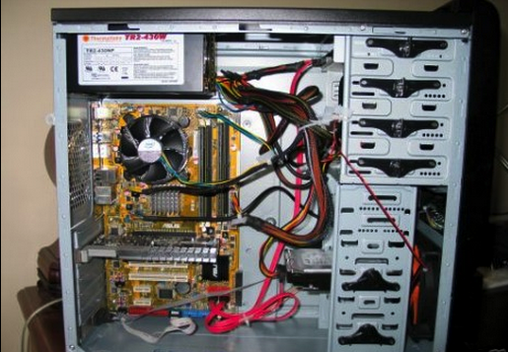
System View: Operating System Definition
OS is a resource allocator
Manages all resources
Decides between conflicting requests for efficient and fair resource use
OS is a control program
Controls execution of programs to prevent errors and improper use of the computer

Slide 10
Operating System Definition (Cont.)
“Everything a vendor ships when you order an operating system” is a good approximation
But varies wildly
“The one program running at all times on the computer” is the kernel.
Everything else is either
a system program (ships with the operating system) , or
an application program.
Notes:
No universally accepted definition

Slide 11
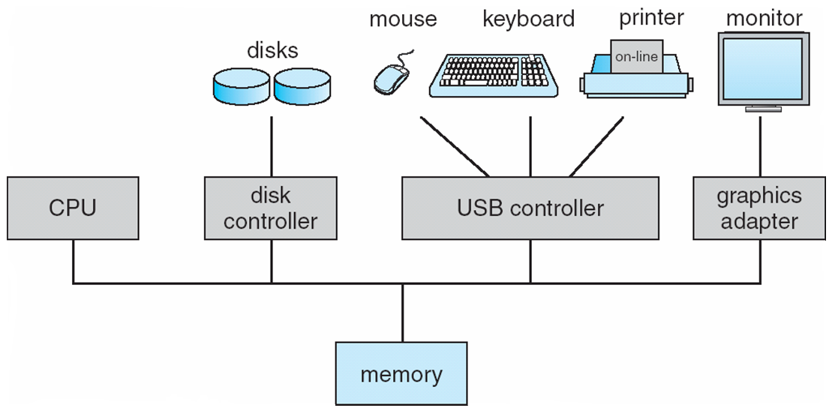
Computer System Organization
One or more CPUs, device controllers connect through common bus providing access to shared memory
Concurrent execution of CPUs and devices competing for memory cycles
Notes:
I/O devices and the CPU can execute concurrently
Each device controller is in charge of a particular device type
Each device controller has a local buffer
CPU moves data from/to main memory to/from local buffers
I/O is from the device to local buffer of controller
Device controller informs CPU that it has finished its operation by causing an interrupt

Slide 12
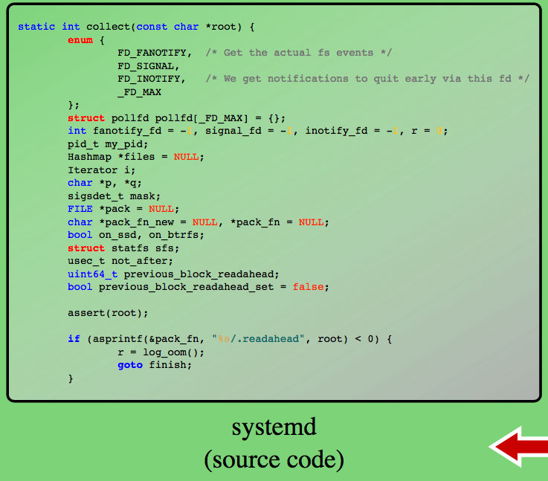
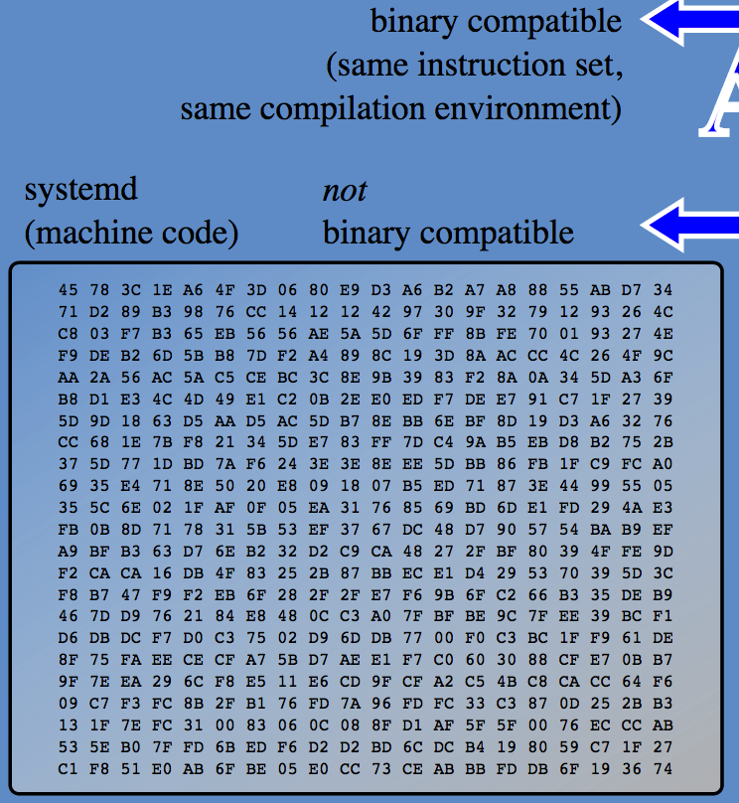
Key Interfaces
Application programming interface (API)
Application binary interface (ABI)
Instruction set architecture (ISA) –COMP4300 (e.g., add $d,$s,$t)
Notes:
ABIs differ from application programming interfaces (APIs), which similarly define interfaces between program components, but at the source code level.
Figure 2.1 also indicates three key interfaces in a typical computer system:
• Instruction set architecture (ISA) : The ISA defines the repertoire of machine
language instructions that a computer can follow. This interface is the boundary
between hardware and software. Note that both application programs
and utilities may access the ISA directly. For these programs, a subset of the
instruction repertoire is available (user ISA). The OS has access to additional
machine language instructions that deal with managing system resources
(system ISA).
• Application binary interface (ABI) : The ABI defines a standard for binary
Reference: https://en.wikipedia.org/wiki/Application_binary_interface
portability across programs. The ABI defines the system call interface to
the operating system and the hardware resources and services available in a
system through the user ISA.
In computer software, an application binary interface (ABI) is the interface between two program modules, one of which is often a library of operating system, at the level of machine code.
• Application programming interface (API) : The API gives a program access
to the hardware resources and services available in a system through the user
ISA supplemented with high-level language (HLL) library calls. Any system
calls are usually performed through libraries. Using an API enables application
software to be ported easily, through recompilation, to other systems that
support the same API.
systemd is a suite of system management daemons, libraries, and utilities designed as a central management and configuration platform for the Linuxcomputer operating system. Described by its authors as a "basic building block" for an operating system,[5] systemd primarily aims to replace the Linux initsystem (the first process executed in user space during the Linux startup process) inherited from UNIX System V and Berkeley Software Distribution(BSD). The name systemd adheres to the Unix convention of making daemons easier to distinguish by having the letter d as the last letter of the filename.

Slide 13
How do you startup a computer?
bootstrap program is loaded at power-up or reboot
Typically stored in ROM or EPROM, generally known as firmware
Initializes all aspects of system
Loads operating system kernel and starts execution
Notes:
When power initialized on system, execution starts at a fixed memory location
Firmware ROM used to hold initial boot code
Operating system must be made available to hardware so hardware can start it
Small piece of code – bootstrap loader, stored in ROM or EEPROM locates the kernel, loads it into memory, and starts it
Sometimes two-step process where boot block at fixed location loaded by ROM code, which loads bootstrap loader from disk
Common bootstrap loader, GRUB, allows selection of kernel from multiple disks, versions, kernel options
Kernel loads and system is then running

Slide 14
Common Functions of Interrupts
Interrupt transfers control to the interrupt service routine through the interrupt vector
Interrupt architecture must save the address of the interrupted instruction
A trap or exception is a software-generated interrupt caused either by an error or a user request
Notes:
Interrupt transfers control to the interrupt service routine through the interrupt vector (contains the addresses of all the service routines)
Interrupt architecture must save the address of the interrupted instruction
A trap or exception is a software-generated interrupt caused either by an error or a user request
An operating system is interrupt driven

Slide 15
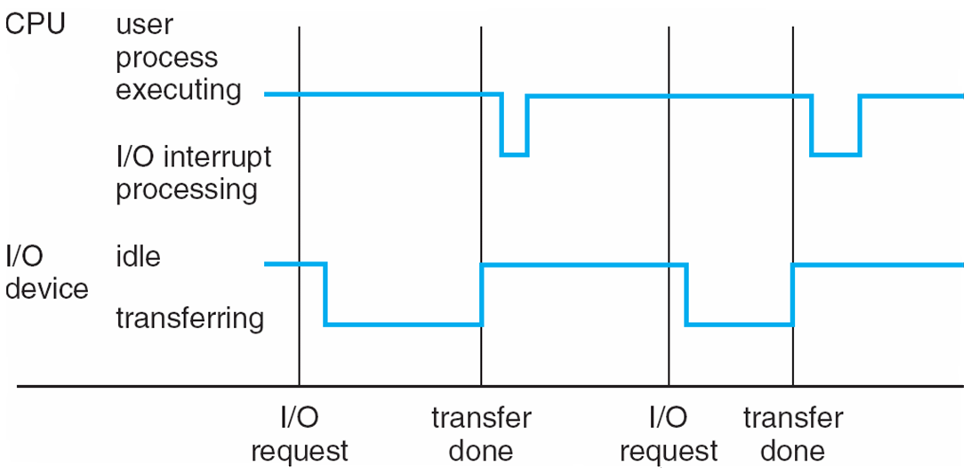
Explain the Interrupt Timeline A single process is doing output
Notes:
Help students to understand this figure.
No explanation in the textbook on page 8, edition 9
I/O Structure
After I/O starts, control returns to user program only upon I/O completion
Wait instruction idles the CPU until the next interrupt
Wait loop (contention for memory access)
At most one I/O request is outstanding at a time, no simultaneous I/O processing
After I/O starts, control returns to user program without waiting for I/O completion
System call – request to the OS to allow user to wait for I/O completion
Device-status table contains entry for each I/O device indicating its type, address, and state
OS indexes into I/O device table to determine device status and to modify table entry to include interrupt
Interrupt Handling
The operating system preserves the state of the CPU by storing registers and the program counter
Determines which type of interrupt has occurred:
polling
vectored interrupt system
Separate segments of code determine what action should be taken for each type of interrupt

Slide 16
Evolution of Operating Systems
What are the reasons for an OS to evolve over time?
Serial Processing
Simple Batch Systems
Multiprogrammed Batch Systems
Time Sharing Systems
Stages include:
Notes:
In attempting to understand the key requirements for an OS and the significance of the major features of a contemporary OS, it is useful to consider how operating systems have evolved over the years.
A major OS will evolve over time for a number of reasons:
• Hardware upgrades plus new types of hardware: For example, early versions
of UNIX and the Macintosh OS did not employ a paging mechanism because
they were run on processors without paging hardware. Subsequent versions
of these operating systems were modified to exploit paging capabilities. Also,
the use of graphics terminals and page-mode terminals instead of line-at-a time
scroll mode terminals affects OS design. For example, a graphics terminal
typically allows the user to view several applications at the same time through
“windows” on the screen. This requires more sophisticated support in the OS.
• New services: In response to user demand or in response to the needs of system
managers, the OS expands to offer new services. For example, if it is found
to be difficult to maintain good performance for users with existing tools, new
measurement and control tools may be added to the OS.
• Fixes: Any OS has faults. These are discovered over the course of time and
fixes are made. Of course, the fix may introduce new faults.
The need to change an OS regularly places certain requirements on its design.
An obvious statement is that the system should be modular in construction, with
clearly defined interfaces between the modules, and that it should be well documented.
For large programs, such as the typical contemporary OS, what might be
referred to as straightforward modularization is inadequate [DENN80a]. That is,
much more must be done than simply partitioning a program into modules. We
return to this topic later in this chapter.

Slide 17
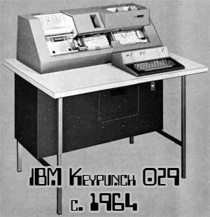
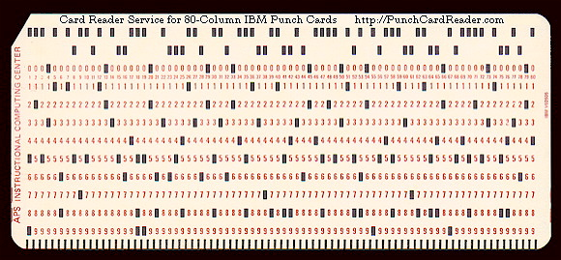
Serial Processing
Earliest Computers:
Problems:
Scheduling:
used a hardcopy sign-up sheet to reserve computer time
time allocations could run short or long, wasting computer time
Setup time
Long system setup time: Must spend time in setting up the program to run
No operating system
Programmers interacted directly with hardware
Computers ran from a console with display lights, toggle switches, some form of input device, and a printer
Users have access to the computer in “series”
Notes:
With the earliest computers, from the late 1940s to the mid-1950s, the programmer
interacted directly with the computer hardware; there was no OS. These computers
were run from a console consisting of display lights, toggle switches, some form of
input device, and a printer. Programs in machine code were loaded via the input
device (e.g., a card reader). If an error halted the program, the error condition was
indicated by the lights. If the program proceeded to a normal completion, the output
appeared on the printer.
These early systems presented two main problems:
• Scheduling : Most installations used a hardcopy sign-up sheet to reserve computer
time. Typically, a user could sign up for a block of time in multiples of a
half hour or so. A user might sign up for an hour and finish in 45 minutes; this
would result in wasted computer processing time. On the other hand, the user
might run into problems, not finish in the allotted time, and be forced to stop
before resolving the problem.
• Setup time: A single program, called a job , could involve loading the compiler
plus the high-level language program (source program) into memory,
saving the compiled program (object program) and then loading and linking
together the object program and common functions. Each of these steps could
involve mounting or dismounting tapes or setting up card decks. If an error
occurred, the hapless user typically had to go back to the beginning of the
setup sequence. Thus, a considerable amount of time was spent just in setting
up the program to run.
This mode of operation could be termed serial processing , reflecting the fact
that users have access to the computer in series. Over time, various system software
tools were developed to attempt to make serial processing more efficient. These
include libraries of common functions, linkers, loaders, debuggers, and I/O driver
routines that were available as common software for all users.

Slide 18

Exercise 4: How to reduce the long system setup time of a serial processing system? (Please use one short sentence to describe your solution.)
Notes:
Story: Wang PC 1968
ItemUnit CostCPU + 4KB RAM$4,950
4KB RAM expansion$2,500
Selectric terminal$4,200
Terminal control unit$500
Cassette storage$1,400
BASIC software and system setup$1,500
Just as multiprogramming allows the processor to handle multiple batch jobs
at a time, multiprogramming can also be used to handle multiple interactive jobs. In
this latter case, the technique is referred to as time sharing , because processor time is
shared among multiple users. In a time-sharing system, multiple users simultaneously
access the system through terminals, with the OS interleaving the execution of each
user program in a short burst or quantum of computation. Thus, if there are n users
actively requesting service at one time, each user will only see on the average 1/ n
of the effective computer capacity, not counting OS overhead. However, given the
relatively slow human reaction time, the response time on a properly designed system
should be similar to that on a dedicated computer.
Timesharing (multitasking) is logical extension in which CPU switches jobs so frequently that users can interact with each job while it is running, creating interactive computing
Response time should be < 1 second
Each user has at least one program executing in memory process
If several jobs ready to run at the same time  CPU scheduling
If processes don’t fit in memory, swapping moves them in and out to run
Virtual memory allows execution of processes not completely in memory

Slide 19
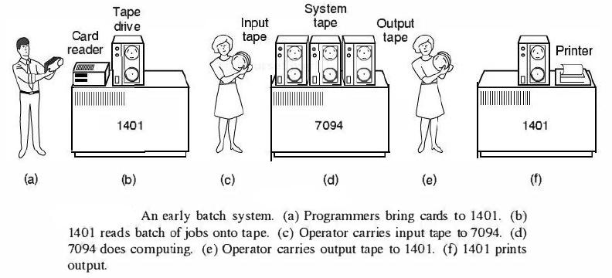
Simple Batch Systems
Early computers were very expensive
important to maximize processor utilization
Monitor
user no longer has direct access to processor
job is submitted to computer operator who batches them together and places them on an input device
program branches back to the monitor when finished
Notes:
Early computers were very expensive, and therefore it was important to maximize
processor utilization. The wasted time due to scheduling and setup time was
unacceptable.
To improve utilization, the concept of a batch OS was developed. It appears
that the first batch OS (and the first OS of any kind) was developed in the mid-1950s
by General Motors for use on an IBM 701 [WEIZ81]. The concept was subsequently
refined and implemented on the IBM 704 by a number of IBM customers. By the
early 1960s, a number of vendors had developed batch operating systems for their
computer systems. IBSYS, the IBM OS for the 7090/7094 computers, is particularly
notable because of its widespread influence on other systems.
The central idea behind the simple batch-processing scheme is the use of a
piece of software known as the monitor . With this type of OS, the user no longer has
direct access to the processor. Instead, the user submits the job on cards or tape to a
computer operator, who batches the jobs together sequentially and places the entire
batch on an input device, for use by the monitor. Each program is constructed to
branch back to the monitor when it completes processing, at which point the monitor
automatically begins loading the next program.

Slide 20
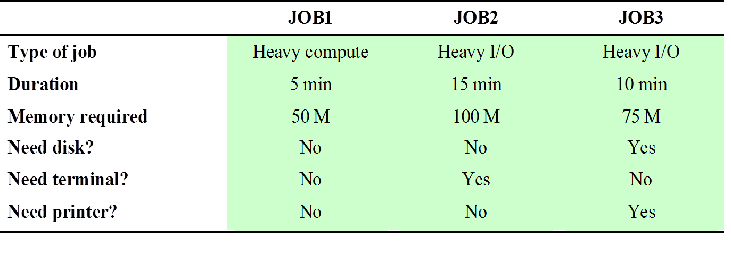
Job Control Language (JCL)
Special type of programming language used to provide instructions to the monitor
what compiler to use
what data to use
Notes:
The monitor performs a scheduling function: A batch of jobs is queued up,
and jobs are executed as rapidly as possible, with no intervening idle time. The monitor
improves job setup time as well. With each job, instructions are included in a
primitive form of job control language (JCL) . This is a special type of programming
language used to provide instructions to the monitor. A simple example is that of a
user submitting a program written in the programming language FORTRAN plus
some data to be used by the program. All FORTRAN instructions and data are on a
separate punched card or a separate record on tape. In addition to FORTRAN and
data lines, the job includes job control instructions, which are denoted by the beginning
$.

Slide 21

Exercise 5 (Plickers): Which statement about simple batch systems is correct?
Highly inefficient
Over utilized CPU time
Deliver high throughput
Offer interactivity of users
Notes:
Under utilized CPU time
Non-interactivity of users with running jobs

Slide 22

Multiprogramming
There must be enough memory to hold the OS (resident monitor) and one user program
When one job needs to wait for I/O, the processor can switch to the other job, which is likely not waiting for I/O
Notes:
This inefficiency is not necessary. We know that there must be enough
memory to hold the OS (resident monitor) and one user program. Suppose that
there is room for the OS and two user programs. When one job needs to wait for
I/O, the processor can switch to the other job, which is likely not waiting for I/O.
Multiprogramming (Batch system) needed for efficiency
Single user cannot keep CPU and I/O devices busy at all times
Multiprogramming organizes jobs (code and data) so CPU always has one to execute
A subset of total jobs in system is kept in memory
One job selected and run via job scheduling
When it has to wait (for I/O for example), OS switches to another job

Slide 23
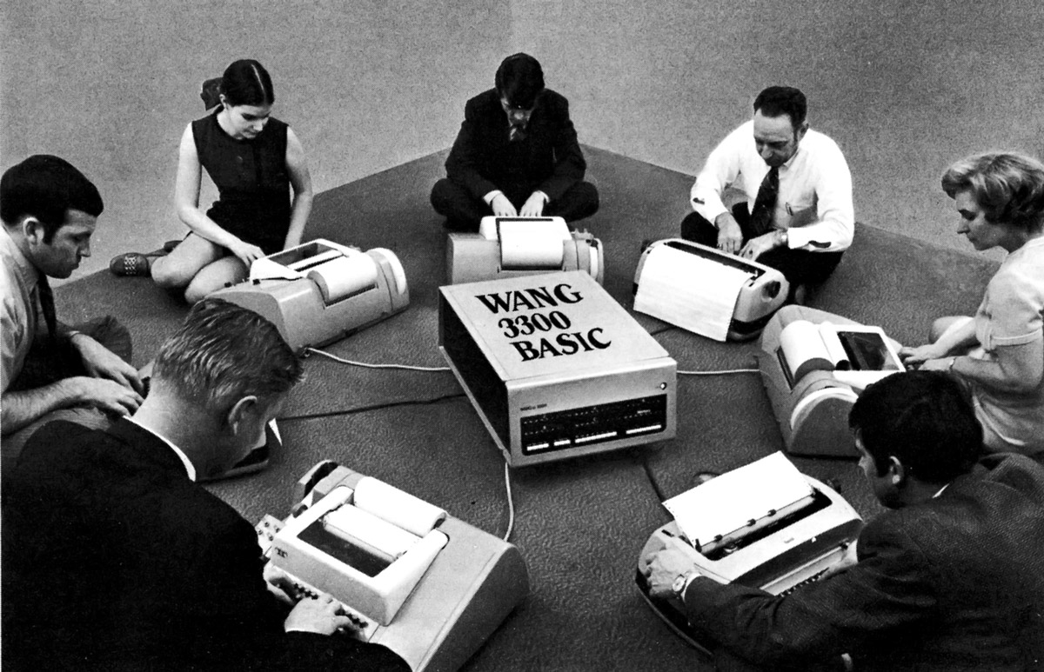
Time-Sharing Systems
To handle multiple interactive jobs
Processor time is shared among multiple users
Multiple users simultaneously access the system through terminals, with the OS interleaving the execution of each user program in a short burst or quantum of computation
Notes:
Wang PC 1968
ItemUnit CostCPU + 4KB RAM$4,950
4KB RAM expansion$2,500
Selectric terminal$4,200
Terminal control unit$500
Cassette storage$1,400
BASIC software and system setup$1,500
Just as multiprogramming allows the processor to handle multiple batch jobs
at a time, multiprogramming can also be used to handle multiple interactive jobs. In
this latter case, the technique is referred to as time sharing , because processor time is
shared among multiple users. In a time-sharing system, multiple users simultaneously
access the system through terminals, with the OS interleaving the execution of each
user program in a short burst or quantum of computation. Thus, if there are n users
actively requesting service at one time, each user will only see on the average 1/ n
of the effective computer capacity, not counting OS overhead. However, given the
relatively slow human reaction time, the response time on a properly designed system
should be similar to that on a dedicated computer.
Timesharing (multitasking) is logical extension in which CPU switches jobs so frequently that users can interact with each job while it is running, creating interactive computing
Response time should be < 1 second
Each user has at least one program executing in memory process
If several jobs ready to run at the same time  CPU scheduling
If processes don’t fit in memory, swapping moves them in and out to run
Virtual memory allows execution of processes not completely in memory

Slide 24
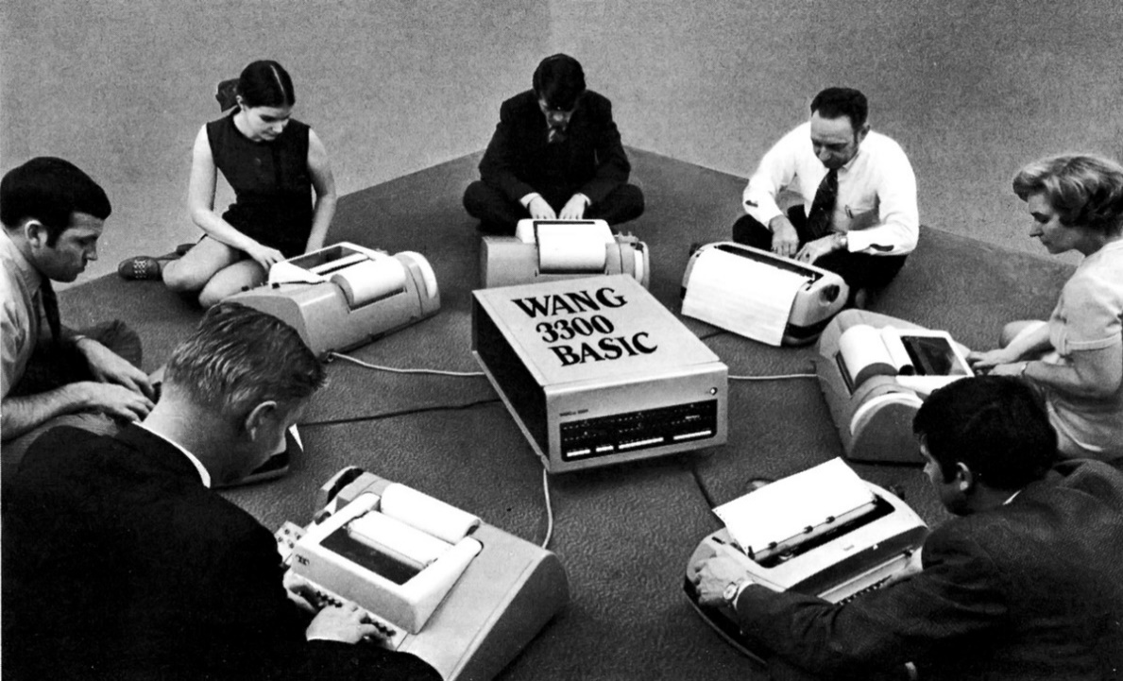
Exercise 6: If there are n users actively requesting service at one time, each user will only see on the average 1/ n of the effective computer capacity, not counting OS overhead. Why the response time on a time-sharing system can be similar to that on a dedicated computer?
Relatively slow human reaction time
Notes:
Story: Wang PC 1968
ItemUnit CostCPU + 4KB RAM$4,950
4KB RAM expansion$2,500
Selectric terminal$4,200
Terminal control unit$500
Cassette storage$1,400
BASIC software and system setup$1,500
Just as multiprogramming allows the processor to handle multiple batch jobs
at a time, multiprogramming can also be used to handle multiple interactive jobs. In
this latter case, the technique is referred to as time sharing , because processor time is
shared among multiple users. In a time-sharing system, multiple users simultaneously
access the system through terminals, with the OS interleaving the execution of each
user program in a short burst or quantum of computation. Thus, if there are n users
actively requesting service at one time, each user will only see on the average 1/ n
of the effective computer capacity, not counting OS overhead. However, given the
relatively slow human reaction time, the response time on a properly designed system
should be similar to that on a dedicated computer.
Timesharing (multitasking) is logical extension in which CPU switches jobs so frequently that users can interact with each job while it is running, creating interactive computing
Response time should be < 1 second
Each user has at least one program executing in memory process
If several jobs ready to run at the same time  CPU scheduling
If processes don’t fit in memory, swapping moves them in and out to run
Virtual memory allows execution of processes not completely in memory

Slide 25
Summary
Basic organization of computer systems
Goals of operating systems
Evolution of Operating Systems
Batching
Multiprogramming
Timesharing

